Slide 1
In the name of Allah, most gracious and merciful
Object Oriented Concepts &Design with Lab
Lecture – 2
Encapsulation

Slide 2
Object Orientation
Object orientation is a technique of modeling a real-world system in software based on objects.
Object is the core concept.
Real world entities/things -> objects of software model.
Example:

Slide 3
Analysis of real life objects
Objects --> ??
Objects – real world persons or things
Object – attributes and behaviors

Slide 4



Object

Slide 5



Object
attributes, behaviors
How to access objects: input, output

Slide 6
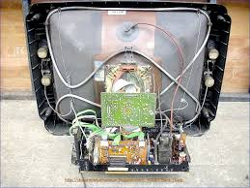
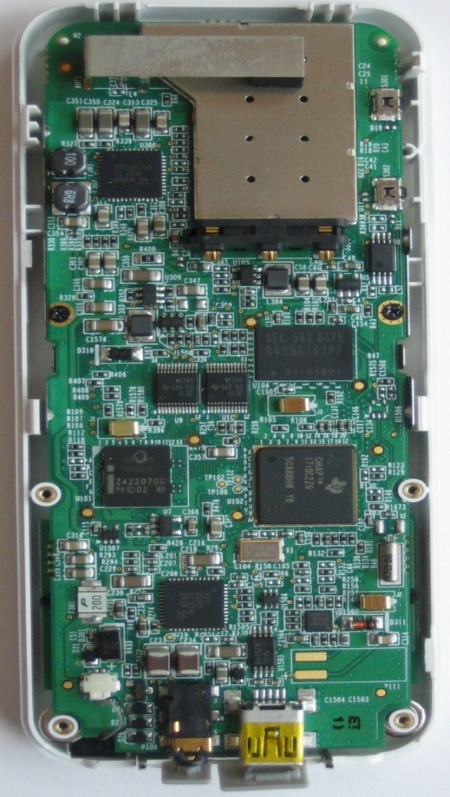
What problem would arise if internal details is accessible to the outside world?

Slide 7
How would you hide internal details from the outside of the world?
In software - how would you hide internal details from the outside of the world?

Slide 8
class mobile{
color;
manufacturer;
ram;
internalCircuit;
powerHouse;
call();
sms();
showManufacturer();
changeRam();
repairInternalCircuit();
changePowerHouse();
}

Slide 9



What are these ?

Slide 10


What is inside?
A small container with medicines inside.
Capsule – encapsulate the medicines

Slide 11
Encapsulation
- to bind related functionality (Methods) & Data (Variables) in a protective wrapper (Class)
with required access modifiers (public, private, default & protected) as single unit
so that the code can be saved from unauthorized access by outer world and can be made easy to maintain.

Slide 12
Encapsulation
Encapsulation in java is a process of wrapping code and data together into a single unit,
For example capsule which is mixed of several medicines.
We can create a fully encapsulated class in java by making all the data members of the class private. Now we can use setter and getter methods to set and get the data in it.

Slide 13
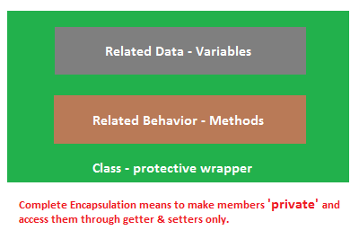
Encapsulation

Slide 14
Encapsulation
In encapsulation the variables of a class will be hidden from other classes, and can be accessed only through the methods of their current class, therefore it is also known as data hiding.

Slide 15
Advantage of Encapsulation in java
It improves maintainability and flexibility and re-usability
By providing only setter or getter method, you can make the class read-only or write-only.
It provides you the control over the data. Suppose you want to set the value of cgpa is greater than 3.8, then the grade is A+.
User would not be knowing what is going on behind the scene. They would only be knowing that to update a field call set method and to read a field call get method but what these set and get methods are doing is purely hidden from them.

Slide 16
Encapsulation
Objects encapsulate data and implementation details. To the outside world, an object is a black box that exhibits a certain behavior.
The behavior of this object is what which is useful for the external world or other objects.
An object exposes its behavior by means of public methods or functions.
The set of functions an object exposes to other objects or external world acts as the interface of the object.

Slide 17
Advantage of Encapsulation in java
Encapsulation plays an important role in object oriented programming. It can be defined as concealing decisions which are related to the design of a computer program.
The purpose of encapsulation is to protect the other parts of the application from changing when one piece of information is changed. To conceal a design decision, a programmer will need to build a strong interface. This interface will cover the rest of the application from any changes that are made.
In contemporary programming languages, the concept of encapsulation has been used in a number of different ways. While some people choose to use encapsulation as a general term for hiding information, others use it in a manner which is much more specific.

Slide 18
Advantage of Encapsulation in java
object oriented programming, the software module may hide the data by encapsulating it within a module which showcases an interface. It will reduce the chances of a software being damaged during its development by transferring the dependency of the code into an interface which is secure.
The elements will carry out operations on the interface so that if a change occurs, it is not necessary for the clients to change as well. In most cases, the information will be hidden by concealing the layout of the data. If the layout is altered, the change will be reduced to a small portion of the program.

Slide 19
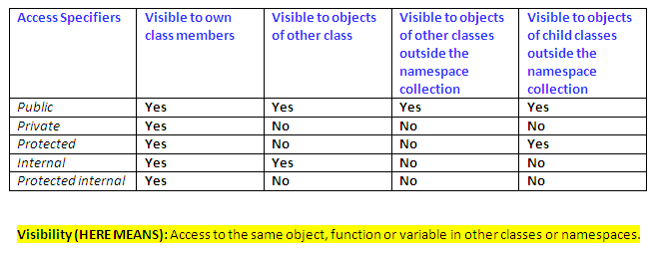
Access Modifier

Slide 20
Advantage of Encapsulation
By providing only setter or getter method, you can make the class read-only or write-only.
It provides you the control over the data. Suppose you want to set the value of cgpa is greater than 3.8, then the grade is A+.

Slide 21
problem
Private members can not be accessed outside of that class.
So what will I do, if I need to change that private member for sake of development??
So what will I do, if I need to access that private member for sake of development??

Slide 22
problem
class student
{
public String name;
private double cgpa; // how to get cgpa?
}

Slide 23
Designing Data Access
A common model for designing data access is the use of accessor and mutator methods.
What are accessor and mutator methods??

Slide 24
Get Accessor
An accessor — also known as a getter — returns an instance variable of an object.
By convention, accessors are usually named getPropertyName.

Slide 25
Box
{
private double height;
private double width;
private double depth;
public Box(double h, double w, double d)
{
height =h;
width = w;
depth = d;
}
public double volume()
{
return height*width*depth;
}
}
class Program{
public static void main(String[] args){
Box myBox = new Box (10,20,30);
System.out.println(“Volume is” +myBox.volume( ));
if (myBox.height ==10) //ERROR
{
System.out.println(“Big Box”);
}
}
}

Slide 26
Class Box
{
private double height;
private double width;
private double depth;
public Box(double h, double w, double d)
{
height =h;
width = w;
depth = d;
}
public double volume()
{
return height*width*depth;
}
public double getHeight() //ACCESSOR
{
return height;
}
}
Class Program{
public static void main(String[] args){
Box myBox = new Box (10,20,30);
System.out.println(“Volume is” +myBox.volume( ));
if (myBox.getHeight() ==10)
{
System.out.println(“Big Box”);
}
}
}

Slide 27
set Accessor
A set Accessor — also known as a setter — changes an instance variable of an object.
By convention, mutators are usually named setPropertyName.

Slide 28
Class Box
{
private double height;
private double width;
private double depth;
public Box(double h, double w, double d)
{
height =h;
width = w;
depth = d;
}
public double volume()
{
return height*width*depth;
}
public void setHeight( double h) //MUTATOR
{
height = h;
}
}
Public Class Main{
public static void main(String[] args){
Box myBox = new Box (10,20,30);
System.out.println(“Volume is” +myBox.volume( ));
myBox.setHeight(10);
}
}

Slide 29
Get Accessor
private string name; // the name field
public string Name // the Name property
{
get {
return name;
}
}
Employee e1 = new Employee(); ... Console.Write(e1.Name);

Slide 30
set Accessor
public string Name
{
get
{
return name;
}
set
{
name = value;
}
}
Employee e1 = new Employee();
e1.Name = "Joe";

